Slide 1

Heuristic Review for Spotify
By Isaac Tan| 2100902B | P11

Slide 2

Introduction
Spotify was founded by Daniel Ek and Martin Lorentzon in Stockholm Sweden.
It has made music streaming more pleasant since the official launch in 2008.

Slide 3
Introduction
The app was developed to tackle the increasing piracy issues that the music industry was facing.
It is currently the most well-known music streaming platform with hundreds of millions of users around the world.

Slide 4
Reference: http://www.vic.gov.au

Slide 5



1
2
3
4
User presses the library button
User presses the “+” icon
User is tasked to name the playlist and then press the “CREATE” button
User is trying to add a new playlist to gather his favrouite songs together
Spotify
Instead of selecting more than one song and adding them into a new playlist straightaway, the app allows only one song to be added at a time.
User may take a long time to add his favourite songs into a new playlist, considering that he has a long list of songs to add.
There are many interfaces on the main page and the user has to trial and error and think which interface or category resembles the most to the page where he can create a new playlist.
The “+” icon is located at the top right corner of the screen and user may overlook it and not realise where the icon is located at.
Naming a playlist is just the user typing a heading to name his playlist, so no pain points during this final step of creating a playlist.
Notes:
You are not limited to only 1 slide, you may add more if task requires more steps,
----------------------------
More info on Channels:
-----------------------------
Channels are the means of interaction between a customer and an organization. Interaction can take place in a website, native app, social media platform (eg. facebook, Instagram) call center, in-store ... etc

Slide 6
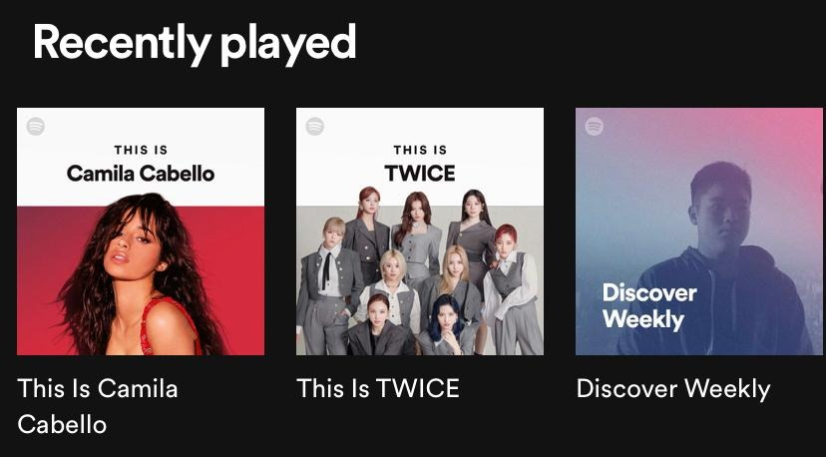
Learnability
The app uses simple headings to classify songs together.
Very easily recognised by the user to direct their attention to that heading.
The “Recently played” category shows all songs/playlists that the user has played recently.

Slide 7
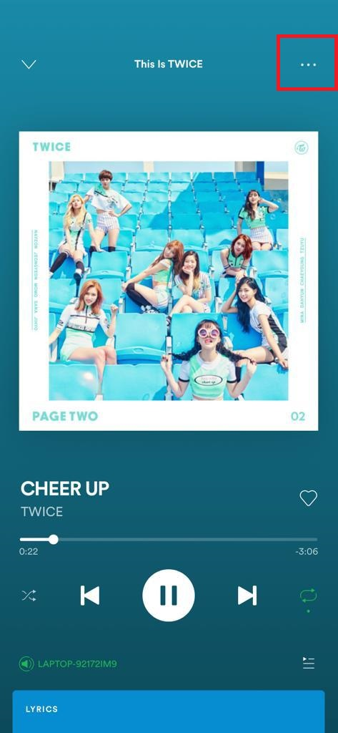
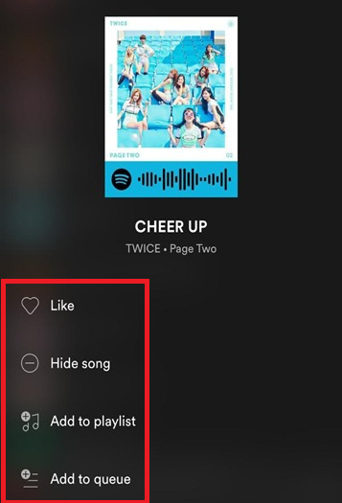
Efficiency
The “…” button is very common to almost all users as this feature means the settings for the song.
Pressing on that feature will pull up a list of functions for the user to decide what to do with the song (e.g., like, hide song, add to playlist, add to queue).
Once knowing where that button locates and what it does, users will naturally lock it in their memory immediately and use it for future purposes.

Slide 8
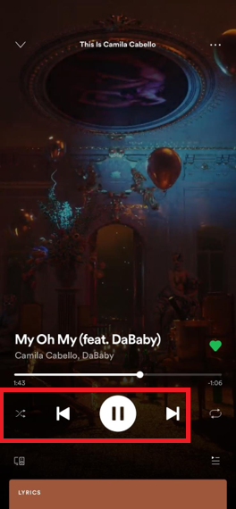
Memorability
All music apps have the basic functions (play/pause, forward/previous, shuffle)
Even after coming back on the app after a long period of time, it is very common-sense and straightforward to know what these buttons do.

Slide 9
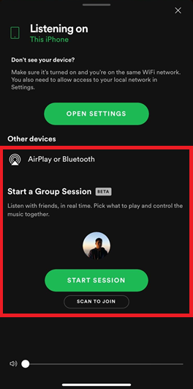
Memorability
However, for more advanced functions such as playing songs on another device, users may take some time to recall how to work their way through this obstacle, but it wouldn’t take long to remember.
“AirPlay or Bluetooth” has a wireless network logo – connects to a wireless device that is near the user to listen on (e.g., wireless headphones/computer).
“Start a Group Session” is self-explanatory to users, and it also includes a short explanation of what it does if users still do not understand – “Listen with friends, in real time. Pick what to play and control the music together.”

Slide 10
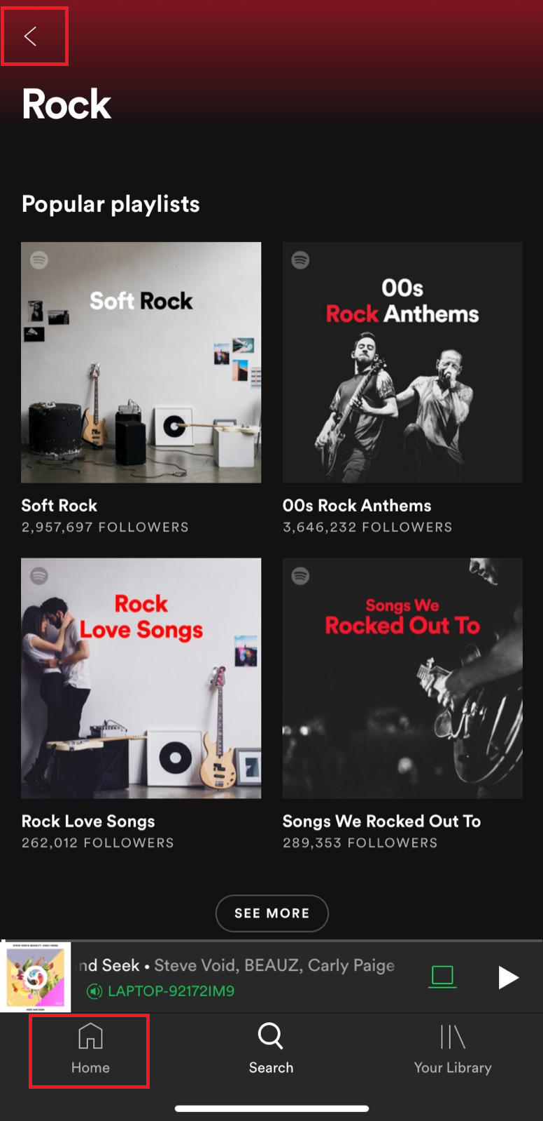
Error Tolerance
Users may clumsily accidentally tap on a playlist/album and would want to go back to the previous page.
They can press the “←” button at the top left corner and a “Home” button at the bottom left corner.
The “←” button is a very commonly-used interface by literally every app in existence and very easily-recognised by users to know what it does.
Pressing either of those buttons will bring the user back to the previous page or the home page.

Slide 11
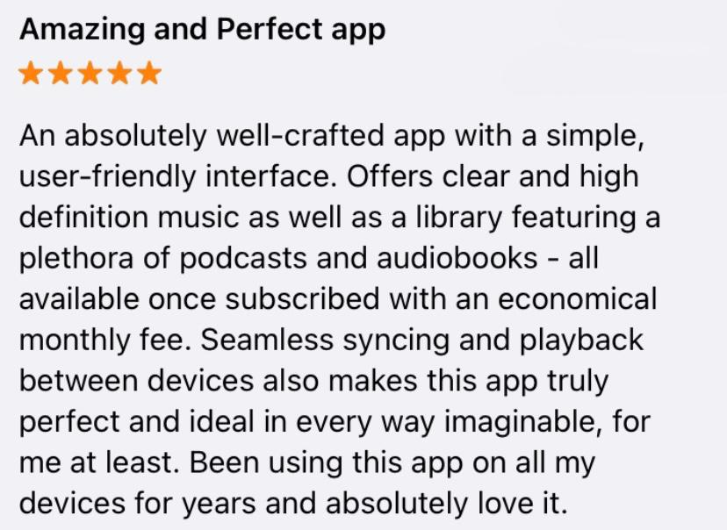
Satisfaction
The app is very simply designed with very minimal confusing interfaces.
It provides a wide range of different podcasts and audiobooks for users to pick and choose which one to listen to.
The basic interfaces of the app (play/pause, forward/previous etc.) are used effortlessly and do not need to think about how it works.
Used by hundreds and millions of people around the world including famous celebrities, the app is perfect in almost every way and is admired by everyone.

Slide 12
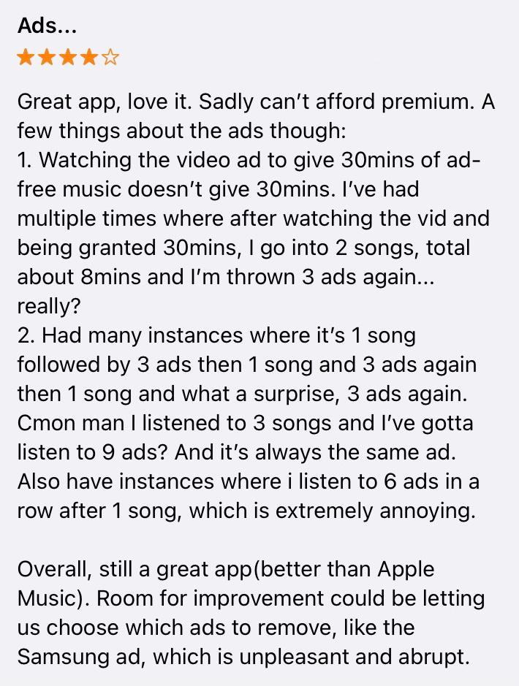
Satisfaction
Though Spotify may look like a pleasant app, some may think otherwise.
Without Spotify premium, the user will be unable to enjoy the fullness of the app with uninterrupted music.
Instead, one will receive 30 second advertisements after every 2-3 songs.
Glitches may happen and instead of receiving 1-3 advertisements after the song, they may receive more than 3 in a row which does not always happen.
This results with the user getting a rise in annoyance with the unending advertisements – may delete and download another music app.

Slide 13
Conclusion
Spotify is very simply-designed with very minimal to no confusing functions.
It uses basic interface buttons, just like other music streaming apps.
One area for improvement is to resolve common-occurring bugs and glitches such as advertisements playing even after 3-4 of them in a row
Despite not having premium, they still should not suffer in continuous advertisement replays.
There were a lot more bad reviews than I expected during this research and it was difficult to find a feature that most users liked.
The research for the background information of the app went very smoothly as it was quite easy to search for it.

Slide 14
References
https://newsroom.spotify.com/company-info/
https://www.bbc.com/news/newsbeat-43240886#:~:text=Founded%20by%20Daniel%20Ek%20and,the%20music%20industry%20was%20facing.&text=This%20cost%20the%20music%20industry,not%20paying%20for%20the%20songs.

